Slide 1
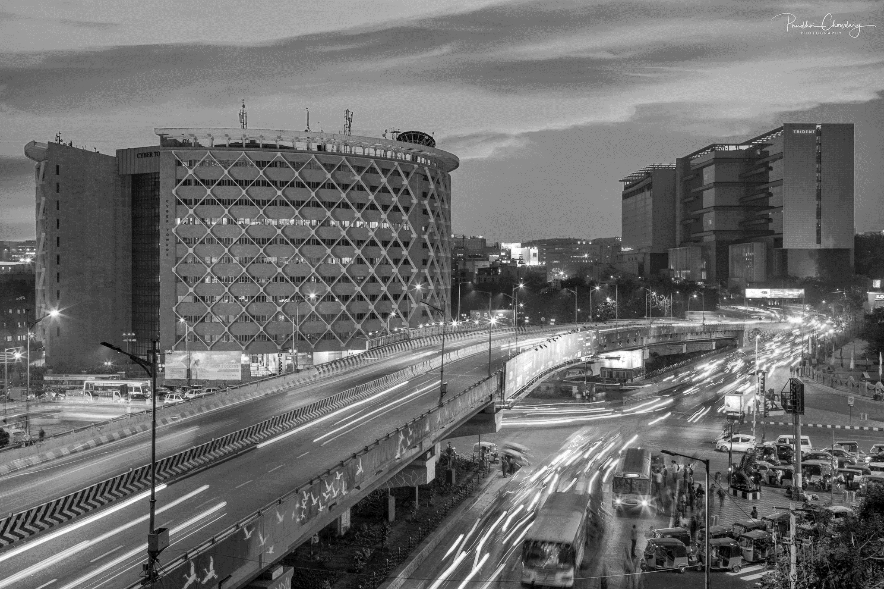
TELANGANA TOURISM INSIGHTS

Slide 2
TELANGANA TOURISM INSIGHTS
CONTENTS
About Telangana
Project Overview & Objective
Project Outline
Preliminary Research Insights
Secondary Research Insights
Other Insights and Recommendation

Slide 3
TELANGANA TOURISM INSIGHTS
CONTENTS
About Telangana
Project Overview & Objective
Project Outline
Preliminary Research Insights
Secondary Research Insights
Other Insights and Recommendation

Slide 4
CONTENTS
TELANGANA TOURISM INSIGHTS
About Telangana
Project Overview & Objective
Project Outline
Preliminary Research Insights
Secondary Research Insights
Other Insights and Recommendation

Slide 5
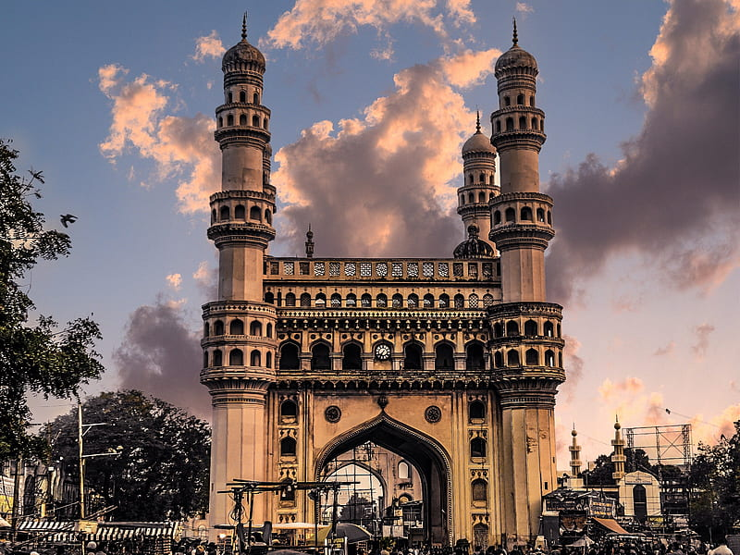
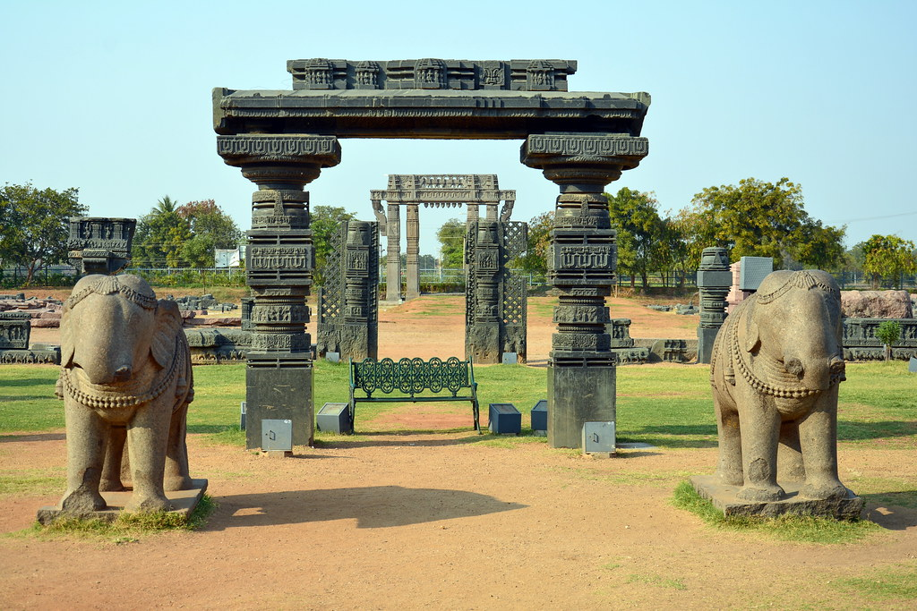
ABOUT TELANGANA
Telangana is a state in southern India. In the capital of Hyderabad, the Charminar is a 16th-century mosque with 4 arches supporting 4 towering minarets. The monument overlooks the city's long-running Laad Bazaar. Once the seat of the Qutb Shahi dynasty, the sprawling Golconda Fort is a former diamond-trading center.
Warangal Fort is located in Warangal District, Telangana, India. It was the capital city of Kakatiya dynasty and the Musunuri Nayakas. It appears to have existed since at least the 12th century when it was the capital of the Kakatiyas.

Slide 6
ABOUT TELANGANA
Telangana is a state in southern India. In the capital of Hyderabad, the Charminar is a 16th-century mosque with 4 arches supporting 4 towering minarets. The monument overlooks the city's long-running Laad Bazaar. Once the seat of the Qutb Shahi dynasty, the sprawling Golconda Fort is a former diamond-trading center.
Warangal Fort is located in Warangal District, Telangana, India. It was the capital city of Kakatiya dynasty and the Musunuri Nayakas. It appears to have existed since at least the 12th century when it was the capital of the Kakatiyas.

Slide 7
PROJECT OVERVIEW AND OBJECTIVE
Telangana is one of the India’s leading company and has published its tourism data under its open data policy. As a data analyst, we have to find the patterns in the given data, do additional research and give data informed recommendations to the Telangana govt which can be used to increase their revenue my improving administrative operations
PROJECT OBJECTIVE : Maximize the revenue by increasing the number of domestic and foreign visitors in the districts of Telangana

Slide 8
PROJECT OUTLINE
UNDERSTANDING BUSINESS PROBLEM AND DATA
DOING RESEARCH TO COLLECT ADDITIOINAL RELEVANT DATA
EXPLORATORY DATA ANALYSIS AND EXTRACTING INSIGHTS
CREATING INSIGHT REPORT AND PRESENTING INSIGHTS
WORK FLOW:
DATA COLLECTION : Extracting census data of Telangana districts using Web Scrapping (Python: BeautifulSoup)
DATABASE STORING: Loaded the dataset into the database and performed some data transformation and data cleaning (Database: PostgreSQL)
DATA ANALYSIS: Answered Preliminary and Secondary research question based on data analysis using SQL and extracted insights. Similarly done in python (Pandas and Seaborn) to get more accurate results.
BUILDING DASHBOARD: Build an interactive dashboard using PowerBI and streamlined with PostgreSQL database to get better visualization of data.
FINAL PRESENTATION: Reporting Insights and give recommendation to increase the number of visitors to generate more revenue.

Slide 9
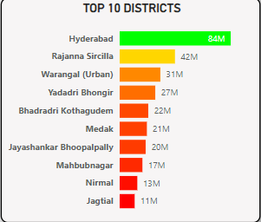
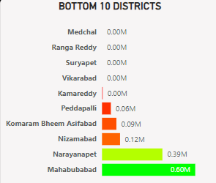
TOP 10 DISTRICTS BASED ON TOTAL NUMBER OF DOMESTIC TOURSITS OVERALL
Hyderabad has the highest number of visitors followed by Rajanna Sircilla and Warangal
These cities have many tourist attractions and have highly developed infrastructure and events which attracts the tourists more
Districts like Medchal, Ranga Reddy, Suryapet, Vikarabad have no visitors. Kamareddy Peddappali and Komaram Bheem accounts the least number of tourists.
These districts have lack of tourist attraction and are not developed.

Slide 10
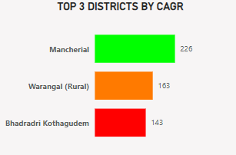
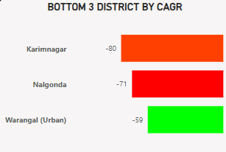
TOP 3 DISTRICTS BASED ON COMPOUND ANNUAL GROWTH RATE OF VISITORS OVERALL
Districts like Mancherial, Warangal, Bhadradri have shown the most CAGR%.
These district may have been developed rapidly and increased tourist attraction spot or organize regular events which may attracted more tourists
Districts like Karimnagar, Nalgonda, and Warangal (urban) have show the least CAGR%
This means that the number of tourist has declined rapidly as compared to past years.
There may be not focusing on development or not organizing or advertising about events and spots.

Slide 11
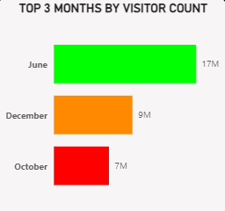
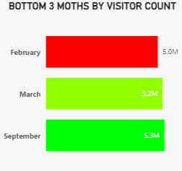
PEAK AND LOW SEASON MONTHS OF HYDERABAD BASED ON VISITORS COUNT
Hyderabad attracted most visitors in the month of June and December
Hyderabad attracted least number of visitors in the month of February and March.
They may organize some special events that will boost number of visitors these months.

Slide 12
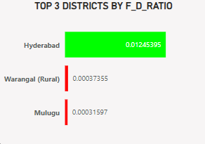
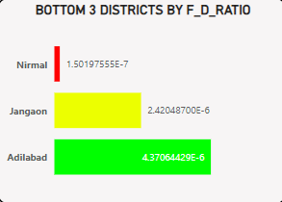
ANALYSIS OF FOREIGN VISITORS BASED ON FOREIGN TO DOMESTIC VISITORS RATIO
Hyderabad have most foreigner to visitor ratio followed by Warangal and Mulugu.
Ratio represents number of foreign visitors with respect to domestic visitors.
Charminar in Hyderabad and Warangal fort in Warangal may attracts high number of foreign tourists.
More than 20 districts have 0 foreigner toursits.
Nirmal, Jangaon and Alibad have the least foreign visitors.
They might lack the tourist spots and cultural events that big districts organizes and attracts less foreigners.

Slide 13
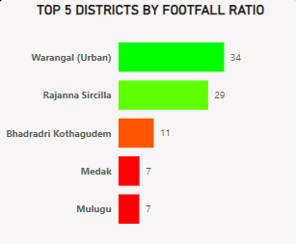
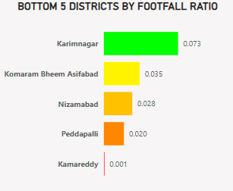
ANALYSIS OF DISTRICTS BASED ON TOURIST TO POPULATION FOOTFALL RATIO
Warangal, Rajanna Sircilla and Bhadradri have highest tourist to population footfall ratio in 2019.
They are the districts which are generating the most revenue in 2019 by visitors
More than 4 districts have 0 visitors in 2019.
Kamareddy, Peddapali and Nizambad attracted the least number of visitors in 2019.
There might be lack of events or development which distinterest the visitors to come

Slide 14
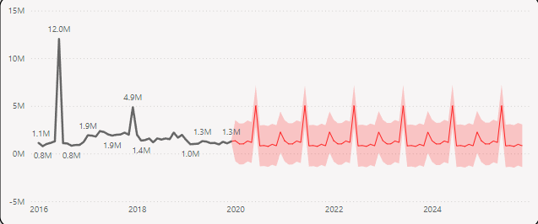
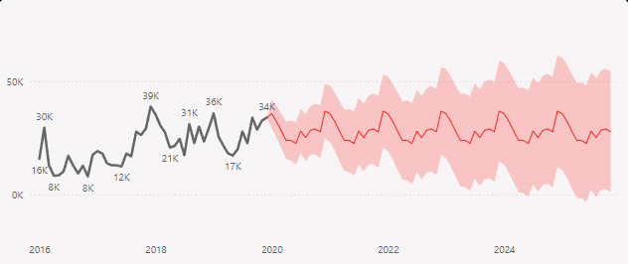
PROJECTED NUMBER OF VISITORS IN HYDERABAD IN 2025
PROJECTED DOMESTIC VISITORS:
4814212
There is a decline of 16% of tourist from 2016-2019 . The declination is continued due to Covid 19 in further years
PROJECTED FOREIGN VISITORS:
1218033
There is a incline of 25% of tourist from 2016-2019 . However this was decreased in coming years due to pandemic

Slide 15
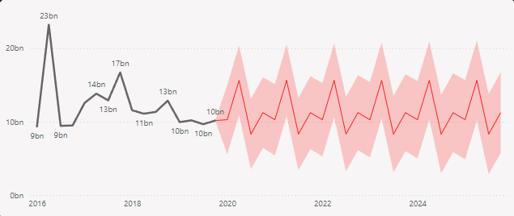
PROJECTED REVENUE IN HYDERABAD IN 2025
DOMESTIC:
FOREIGN:
26959587200
1461639600

Slide 16
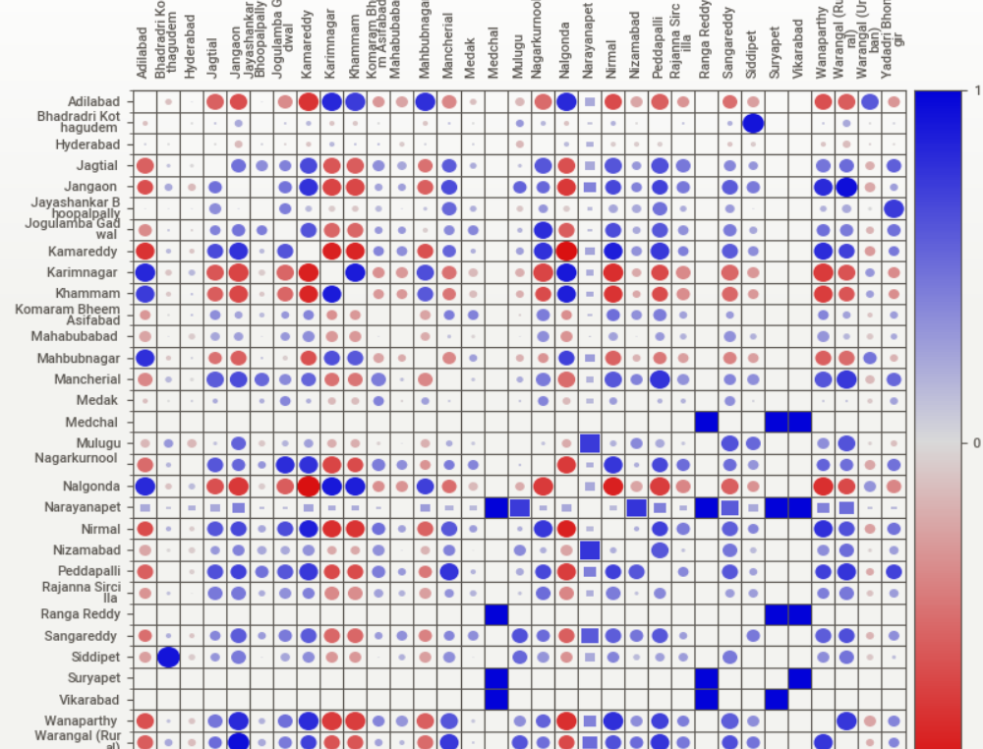
HEAT MAP OF VARIOUS DISTRICTS AFFECTING NUMBER OF TOURISTS IN OTHER DISTRICTS

Slide 17
ADDITIONAL RECOMMENDATIONS
Warangal (Urban & rural), Bhadradri Kothagudem and Medak have the most potential to attract tourists.
Months of February, January and June are the peak months which attracted most domestic and foreign visitors. Government can plan events in these months to boost there revenue.
There are many district which attracts 0 foreigners. So they can build some tourist spots and organize cultural events to boost tourism in those areas.
Based on the heat map we can identify which districts can affect the number of visitors in other districts. For example Jangaon can affect the number of visitors in Warangal Rural or vice versa so govt can do strategic planning for both districts so that both districts can attracts visitors without any interruption.
Government can also plan some more events on the districts which are performing moderate to low. They can develop there infrastructure and cultures.
Overall there are crime rates which are increasing in many districts so government can also issue some security which can be affective.
Maintaining cleanliness in rural and underdeveloped areas may also help.

Slide 18


